Slide 1

Reducing Emissions from Commercial Buildings
Colin Haley
July 2026

Slide 2
Agenda
01
01
Executive Summary
Executive Summary
02
02
Data Description
03
Research Questions
04
Methodology
05
Results and Findings
06
Conclusion

Slide 3
Executive Summary
1
Background & Objective
Significance
Insights & Recommendations
Through this exercise, our analysis was able to:
  Determine that Retrofits reduce carbon emissions more compared to any other variable.
  Find that square footage and the Retrofit status of a building are the key drivers in carbon emissions, positively and negatively.
  Retrofit Status Definition: A building with confirmed retrofit status indicates the structure has been upgraded to drastically reduce greenhouse gas emissions, whereas a un-retrofitted status means it relies on inefficient systems.
The Kansas City Office of Sustainability is evaluating policies to reduce CO₂ emissions from large commercial office buildings. In particular, the city is interested in understanding which building characteristics drive annual emissions, and whether energy retrofits change how building size impacts emissions.
We have been given data on 120 office buildings with a variety of carbon emission data.
For all buildings greater than 100,000 square feet, implement retrofit status on those buildings to best reduce emissions.
Plans for smaller buildings should be less focused on retrofit status, and more focused on reducing the square footage alone.
If we are looking for additional analytics, we should use Energy Star Score as another consistent variable in helping us determine which buildings are most likely to reduce emissions, with higher scores be more likely to have lower levels of emissions.

Slide 4
Data Description
2
Response Variable:
  Emissions_tons (Numeric - Continuous): Annual CO₂ emissions (metric tons)
Predictors:
  FloorArea_kSqFt (Numeric - Continuous): Building size (thousands of sq ft)
  EnergyStarScore (Numeric - Continuous): Energy efficiency rating (1-100; higher is more efficient)
  RetrofitStatus (Categorical - Nominal): Building status regarding retrofit projects
    Dummy variable :
      RetrofitStatusDummy
        Retrofit is the reference category
  TransitScore (Numeric - Continuous): Public transit accessibility score (0-100)
  OccupancyRate (Numeric - Continuous): Average annual occupancy rate (%)
BuildingID Emissions_tons FloorArea_kSqFt EnergyStarScore RetrofitStatus TransitScore OccupancyRate
1 20 51.2 35.6 Retrofit 33.6 77.7
2 86.1 224.2 69.1 Retrofit 89.7 91.6
3 84.7 234.5 68.7 Retrofit 84.6 57.9
4 71.7 122.5 38.2 Retrofit 42.5 96.6
5 63.2 109.3 70 No Retrofit 97.6 51.9

Slide 5

Research Questions
Which aspects of commercial buildings drive carbon emissions?
3
Common themes across predictors
Influence on city planning
Is energy retrofit effective in reducing emissions compared to other factors?
Impact of energy retrofit and scale
Predicted level of emissions

Slide 6
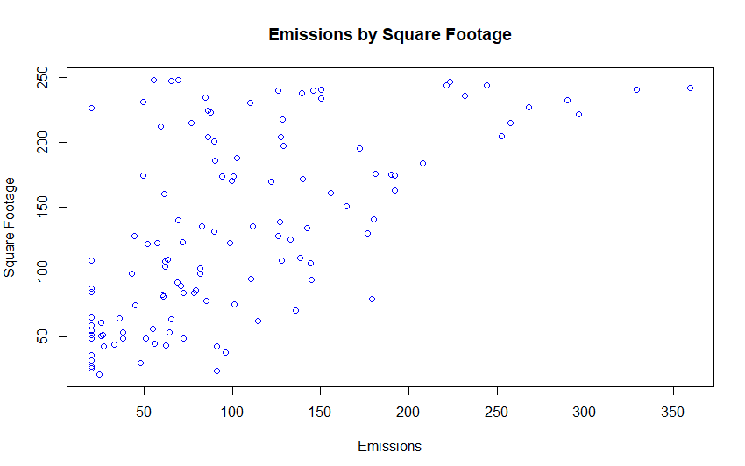
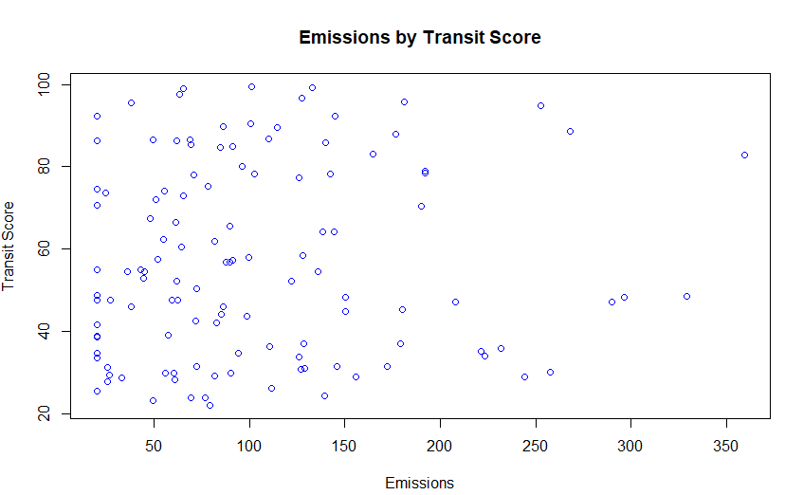
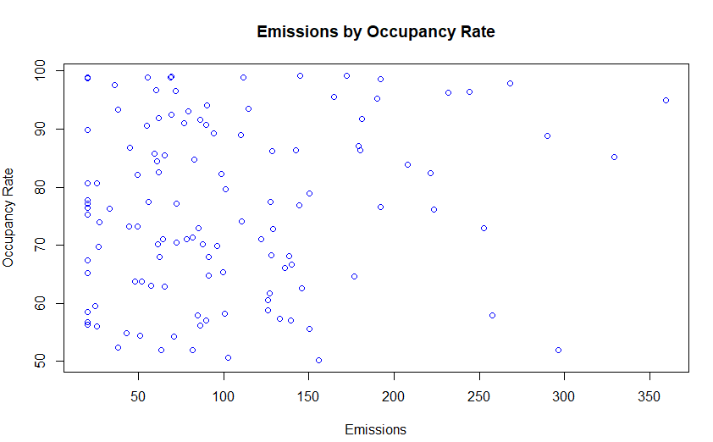
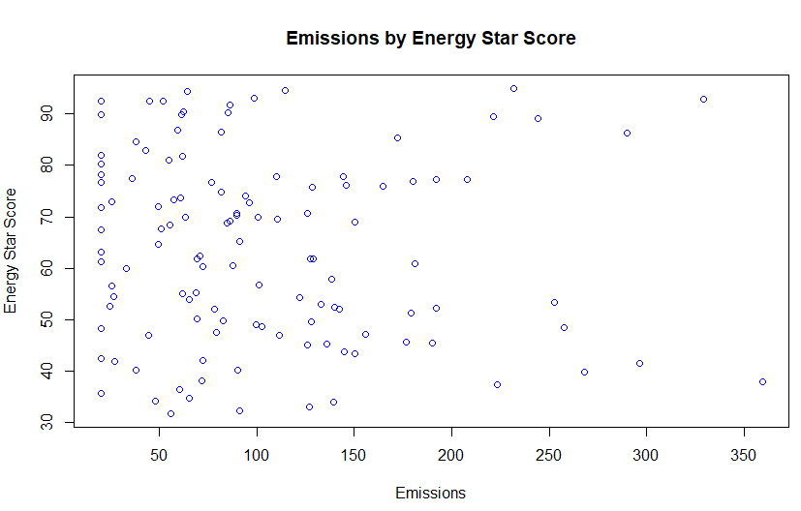
Data Preprocessing & Exploratory Data Analysis
4
Data Cleaning
  Removed na/null values
  Converted variables to appropriate data types
  Converted categorical variables with dummy variable
Data Visualization and Analysis
  Generated summary statistics
  Generated scatterplots for all numerical predictors vs. the response variable
Variable | Mean | Standard Deviation | Minimum | Maximum
Emissions_tons | 103.1 | 72.155 | 20 | 359.3
FloorArea_kSqFt | 133.1 | 71.41 | 20.7 | 248
EnergyStarScore | 63.64 | 17.93 | 31.7 | 95
TransitScore | 56.99 | 23.14 | 22 | 99.5
OccupancyRate | 76.32 | 14.7 | 50.2 | 99.2

Slide 7
Methodology and Analytical Tools
Simple Linear Regression
Multiple Linear Regression
R
5
Very efficient and does not require high computational power
Provides strong predictive power of a single numerical or categorical variable for a single numerical response variable
Highly interpretable coefficients that shows us exactly which predictors are the most valuable
Efficient modeling method that also does not require high computational power
Same predictive power as simple linear regression, but instead we can use multiple numerical and categorical variables for a numerical response variable
Additional interpretability by allowing all predictors to be used in one regression model
Programming language built specifically for complex data analysis
Advanced data visualization packages allowing for in-depth analysis for delivery to non-technical audiences
Multiple data modeling packages available for deeper analysis techniques

Slide 8
Results & Findings
Takeaways
Simple Linear Regression:
Building size as the predictor.
  Estimated regression equation: Yhat = 21.9775 + .60963*(building size)
R² Value Interpretation:
  Our R2 value for this model is .364. This means that 36.4% of the variation in emissions can be explained solely by the square footage of the building we are analyzing.
Based on the output from our model, we should determine that NO, this model is NOT sufficient for sustainability policy decisions. This is because we are only using one variable in our model. We need additional predictors to create a more reliable model. We know this based on our R2 value of .364. Since only 36.4% of variability in emissions is explained by this model, we want to add more variables to determine if we can increase the R2 and explain more about emissions from our model.
Multiple Linear Regression:
Estimated regression equation: Yhat = 70.937 +.70045*(Square Footage) - .61628*(Energy Star Score) - 69.88*(No Retrofit) - .18029*(Transit Score) + .28365*(Occupancy Rate)
Statistical Significance at α = 0.05:
  Square Footage, Energy Star Score, and Retrofit Status are all statistically significant at the .05 significance level
Effect of Retrofit After Controlling for Other Variables:
  Yes, retrofit does appear to reduce emissions. This is based on the dummy variable we created where we used Retrofit as the reference category. We determined that Retrofit decreased emissions by approximately 69.88 units more than No Retrofit based on the model that we created.

Slide 9

Conclusion
Overall Summary
Based on our analysis of emissions when comparing the factors of square footage, energy star score, transit score, retrofit status and occupancy rate, we believe that the key drivers in carbon emissions are square footage and retrofit status.
Retrofits Effectiveness
Retrofits positively impact our ability to reduce carbon emissions based on building size. We have determined that the larger the building, the more likely a retrofit upgrade will be in reducing carbon emissions. For smaller buildings, retrofit may not be as effective in reducing emissions.
City Planning Recommendation
For all buildings greater than 100,000 square feet, implement retrofit status on those buildings to best reduce emissions.
Plans for smaller buildings should be less focused on retrofit status, and more focused on reducing the square footage alone.
If we are looking for additional analytics, we should use Energy Star Score as another consistent variable in helping us determine which buildings are most likely to reduce emissions, with higher scores be more likely to have lower levels of emissions.

